Slide 1

York SSIS & SSAS Code Migration Presented to: York Leadership Nov 1st, 2024

Slide 2
Development Process – ETL Packages
Git Repository Creation:
Developer creates feature branch cloning the latest Development branch. The name of the feature branch will be same as project name (e.g., YRT_ETL_MDW_MFP)
Periodically Git Repo will be synced with the Development Repository to reduce the merging conflict later
Peer Review:
Code review will be focused on accuracy and adherence to guidelines
Criteria of reviews will be on correctness and compliance with coding standard
Frequency of review will once the developer formally completes development.
Any discrepancies observed will be fixed before moving the project to Unit Testing
Final Review:
Once the peer review and Unit Testing is passed code will be finally reviewed and executed by the Architect or Tech Lead and reviewed thoroughly before submitting it for a code merge.
The final review process will combine abridged steps from both Peer Review and Unit Testing.
Code Handover:
After successfully completing steps 1 through 6, the code will be submitted for approval and merged into the Development branch for deployment to both the Development and Production environments.
Any defects found will be addressed by the development team, following the same process as the initial development (Steps 1 through 6).
1
2
3
4
5
6
Development Activity:
Developer change the connection at project level
Developer removes all the references and hard coding corresponds to 2017 database.
Disabled nodes are in context and will be worked on
Any missing database object(s) will be documented and recorded in the RAID Log for further action.
Unit Testing:
All the peer reviewed ETL Projects will be Unit tested with time boxed data available in the 2022 Transaction Data Stores and Enriched Data Store.
The strategy of Unit Testing will be based on error free execution, removal of 2017 references and with evidence of specific Datawarehouse table(s) are populated.
Documentation:
Peer review document in specific template
Unit Testing results and evidence in specific template
Final Review results in specific template
All these documents will be submitted along with the code for review
2
© 2024 IBM Corporation

Slide 3
Development Process – Cube
Git Repository Creation:
Developer creates feature branch cloning the latest Development branch. The name of the feature branch will be same as project name (e.g., YRT_ETL_MDW_MFP)
Periodically Git Repo will be synced with the Development Repository to reduce the merging conflict later
Peer Review:
Code review will be focused on accuracy and adherence to guidelines
Criteria of reviews will be on correctness and compliance with coding standard
Frequency of review will once the developer formally completes development.
Any discrepancies observed will be fixed before moving the project to Unit Testing
Final Review:
Once the peer review and Unit Testing is passed Cube will be finally reviewed and tested by the Architect or Tech Lead and reviewed thoroughly before submitting it for a code merge.
The final review process will combine abridged steps from both Peer Review and Unit Testing.
Code Handover:
After successfully completing steps 1 through 6, the code will be submitted for approval and merged into the Development branch for deployment to both the Development and Production environments.
Any defects found will be addressed by the development team, following the same process as the initial development (Steps 1 through 6).
1
2
3
4
5
6
Development Activity:
Developer change the connection at project level
Developer removes all the references and hard coding corresponds to 2017 database.
Disabled nodes are in context and will be worked on
Create the views as per the Naming Standard
Any missing database object(s) will be documented and recorded in the RAID Log for further action.
Unit Testing:
All the peer reviewed ETL Projects will be Unit tested with time boxed data available in the 2022 Transaction Data Stores and Enriched Data Store.
The unit testing strategy will focus on removing outdated 2017 references, ensuring views are created following naming conventions, and verifying that specific cubes are successfully compiled and can be queried.
Documentation:
Peer review document in specific template
Unit Testing results and evidence in specific format
Final Review results in specific template
All these documents will be submitted along with the code for review
3
© 2024 IBM Corporation

Slide 4
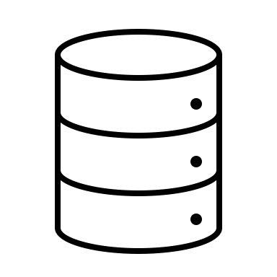

Unit Testing Process
Challenges:
Since the 2017 database is a read-only production database
Making static is not feasible.
Running ETL packages or scripts for testing purposes is not permitted in this environment.
Data Flow in MSQL Server 2022
Unit Testing Strategy (YRT_ETL_MDW_MFP):
As time-boxed data snapshots from the Production Database (2017) are being loaded into Development (2022), it will be impractical to match record counts between the source and target databases due to incremental updates in the current Production Database. Under these conditions, Unit Testing will adopt an Ad Hoc testing strategy to identify unexpected issues through informal testing. Since there are no changes to business logic, the development team will ensure the following:
ETL Projects:
The ETL package executes successfully without any errors.
All references to the 2017 database are removed, including any in disabled nodes.
The ETL package generates output in the designated Data Warehouse tables.
Cubes:
Connections are set to new database (2022)
Views are all created as per the naming conventions provided.
The Analytical Cubes are complied
All references to the 2017 database are removed
OTHERS_OperationDataStore
Snapshot data from 2017
ETL Process
INIT_OperationDataStore
TRANSIT_DataMart
INIT_TRP_Enriched
OTHERS_Enriched
4
© 2024 IBM Corporation

Slide 5
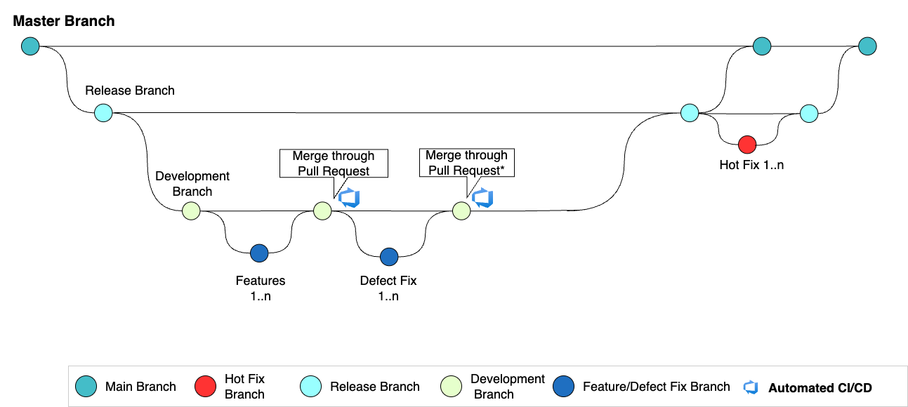

Development Git Workflow – ETL Packages
Development Process
1
Developer creates the feature branch from Development Branch for ETL packages and starts the coding
2
Once development is complete and unit testing is done locally in Visual Studio, the developer will:
Sync the code with the remote Git repository on the Development branch.
Commit the code to the feature branch.
Create a pull request to merge the code.
3
2
1
4
3
Pull Request is being reviewed by the approver and merged into Development Branch:
Automated CI/CD pipeline triggers to build the code and deploy it into Development environment.
4
Any defects identified during the code merge review process will follow steps 1 to 3 for resolution
Unit Testing Process
DevOps Process
1
Once the migration changes for the ETL packages are complete, unit testing will be conducted in the local Visual Studio environment.
1
For the ETL packages merged into Development branch the Build Process will trigger automatically.
2
Unit Testing will be limited to the following:
Package executed successfully.
Data form source database are updated in the target database.
Functional Testing or data consistency checking will be part of UAT.
2
The York team will handle the manual deployment to both the Development and Production environments.
Milestone
5
© 2024 IBM Corporation

Slide 6
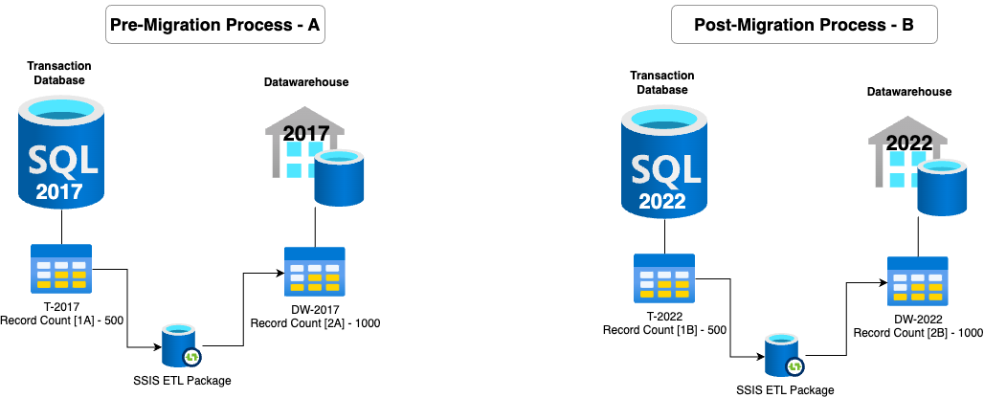
Development/Migration Workflow – ETL Packages
After Code Change
2022 → 5 databases ( 1 DW, 4 Transaction)
Unit Testing Strategy (YRT_ETL_MDW_MFP):
Get a snapshot of all the tables for YRT_ETL_MDW_MFP for transaction tables (OperationDataStore and Enriched DB) on a specific date for MSQL Server - 2017
Get the count of records all transaction tables (MSQL Server – 2017)
Get the count of records in the associated DataMart database (MSQL Server – 2017)
Load all the tables for YRT_ETL_MDW_MFP for transaction tables (OperationDataStore and Enriched DB) on a specific date for MSQL Server – 2022
After code migration run the YRT_ETL_MDW_MFP packages and count the records in associated DataMart database (MSQL Server – 2022)
Assumption:
T-2017 and T-2022 are identical
DW-2017 and DW-2022 are identical
Unit Testing will be performed on the record count as follows:
Verify record count of T-2017 and T-2022 ( 1A = 1B)
Verify record count of T-2017 and T-2022 ( 2A = 2B)
D1
[1,2,3]
D2
[4]
D3
D4
[5]
6
© 2024 IBM Corporation

Slide 7
Development and DevOps Workflow – Analytical Cubes
Development Process
1
Developer creates the feature branch from Development Branch for ETL packages and starts the coding
2
Once development is complete and unit testing is done in Visual Studio, the developer will sync the code with the remote Git repository (Development branch) and create a pull request to merge the code.
3
2
3
Pull Request is being reviewed by the approver and merged into Development Branch.
Once merging is complete, automated CI/CD pipeline triggers to build the code and deploy it into Development environment.
1
4
4
Any defects identified during the code merge review process will follow steps 1 to 3 for resolution
Unit Testing Process
1
Once the migration changes for the ETL packages are complete, unit testing will be conducted in the local Visual Studio environment.
2
Unit Testing will be limited to the following:
Package executed successfully
Data form source database are updated in the target database.
Functional Testing or data consistency checking will be part of UAT.
7
© 2024 IBM Corporation

Slide 8
Development and DevOps Workflow – Analytical Cubes
CUBE: Transit Operation
CUBE: Prestro
Linked Server (M5UAT)
Pre-existing Logic Failing
8
© 2024 IBM Corporation

Slide 9
Context
A highly skilled IBM team of experts skilled in Data Integration and MDM have been engaged since July 3rd 2024, working with the BDM Chief Architect Office and the BDM business teams to develop a set of recommendations for: Data Integration & MDM Strategy
Supporting BDM and Canada’s future client engagement scenarios
Today we are presenting to ESDC BDM Leadership, IBM’s views on the topic.
IBM Data Fabric / © 2024 IBM Corporation
9

Slide 10
Agenda
Enterprise Data Integration Approaches - an industry point of view
IBM's viewpoint on Data Integration required to support typical uses cases including GenAI
A preliminary view of Data Integration approach for BDM, including Master Data Management (MDM)
Master Data Management (MDM) refers to the practice of managing shared data assets critical to an organization's operations and strategic objectives. These data assets typically include customer, product, location, and supplier information. Effective MDM strategies ensure consistency, accuracy, and completeness of these data elements, enabling better decision making, streamlined operations, and enhanced collaboration across organizations.
IBM Data Fabric / © 2024 IBM Corporation
10

Slide 11
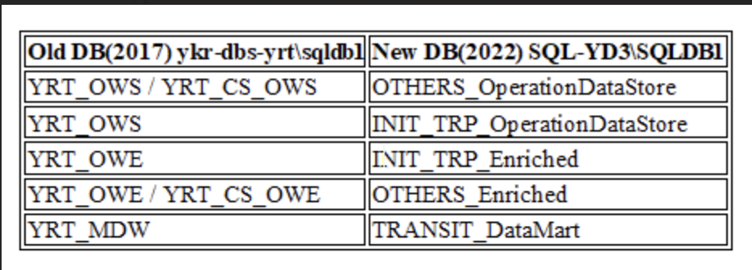

Slide 12

Data Fabric enables a “trusted factory” approach for innovation
Data Assets
Data Products
Connect
Profile
Classify and Enrich
Prepare / Transform
Publish
Lifecycle and governance
Connect
Establish connectivity to physical data sources.
Profile
Assess the quality of data assets.
Classify and Enrich
Classify data assets, assign data policies and rules, and enrich with semantics.
Prepare / Transform
Engineer data assets into trusted data products.
Publish
Publish data products and enable subscription to data products based on data contracts.
Lifecycle and Governance
Implement DataOps principles throughout the lifecycle and enforce governance end-to-end.
IBM Data Fabric / © 2024 IBM Corporation
12

Slide 13
Our Client Pain Points Around Data
Consistent View
Enterprises struggle to consistently view all their data assets, regardless of where they are stored (e.g., competitor stores, other clouds, and SaaS)
Self-Serve
Chief Data Officers are worried that users can't find and use the right data in a timely and governed manner
Different Vocabularies
Different personas need to use different vocabularies for the same asset
Govern
Customers struggle to define and manage governance and security policies spanning on-prem, public clouds, and SaaS from a single pane of glass
Protect and Monitor
Security / risk / governance officers worry about risk of data loss and inability to detect and swiftly respond to threats
Comply
Companies find cloud adoption slow and complex due to ever evolving regulations and privacy laws
IBM Data Fabric / © 2024 IBM Corporation
13

